Slide 1


Slide 2


What is Airbnb?
Airbnb began in 2008 when two designers who had space to share hosted three travelers looking for a place to stay. Now, millions of hosts and travelers choose to create a free Airbnb account so they can list their space and book unique accommodations anywhere in the world. And Airbnb experience hosts share their passions and interests with both travelers and locals.
Useful info
Airbnb has 5.6 million active listings worldwide.
There are at least 100,000 cities with active Airbnb listings.
150 million people use Airbnb to book vacation stays or experiences.
Over 800 million guests have stayed at Airbnbs.
Airbnb has listings in more than 200 countries and regions.
airbnb madrid
2

Slide 3

Most common questions
Why should we search on Airbnb platform?
What types of rooms can we find on Airbnb ?
How much does an Airbnb apartment costs ?
What amenities are most common ?
What are the most common criteria according to which we can choose an Airbnb apartment ?
airbnb madrid
3

Slide 4

Airbnb Madrid Analysis
In this presentation we are going to analyze Madrid Airbnbs. This dataset was taken from https://www.kaggle.com/rusiano/madrid-airbnb-data.
Topics
Room types
Top Ratings and their Prices
Most Common Amenities
Neighborhoods
Map of the Top 100 Airbnbs in Madrid
airbnb madrid
4

Slide 5
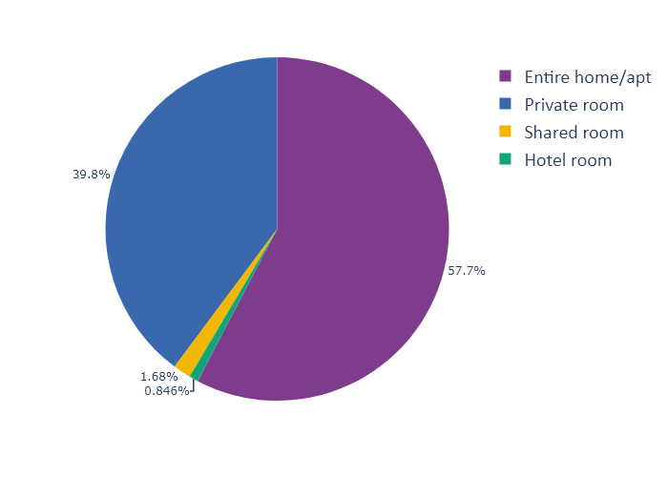
Total numbers of room types in
airbnb madrid
Entire home/apartment | 11314
Private room | 7809
Shared room | 329
Hotel room | 166
airbnb madrid
5

Slide 6
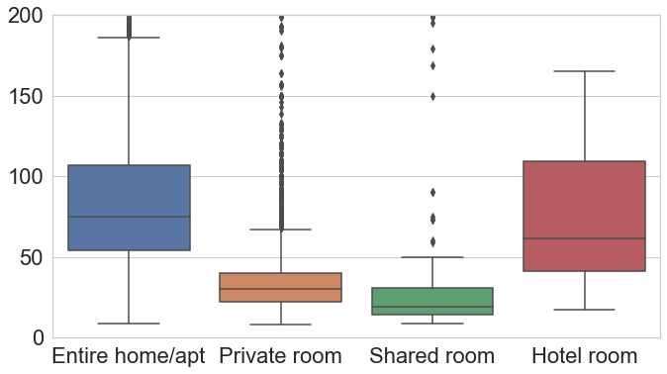
Average prices
Room types | Average price (Euros €)
Ent. apartment | 98
Hotel room | 102
Private room | 39
Shared room | 36
a
airbnb madrid
6

Slide 7
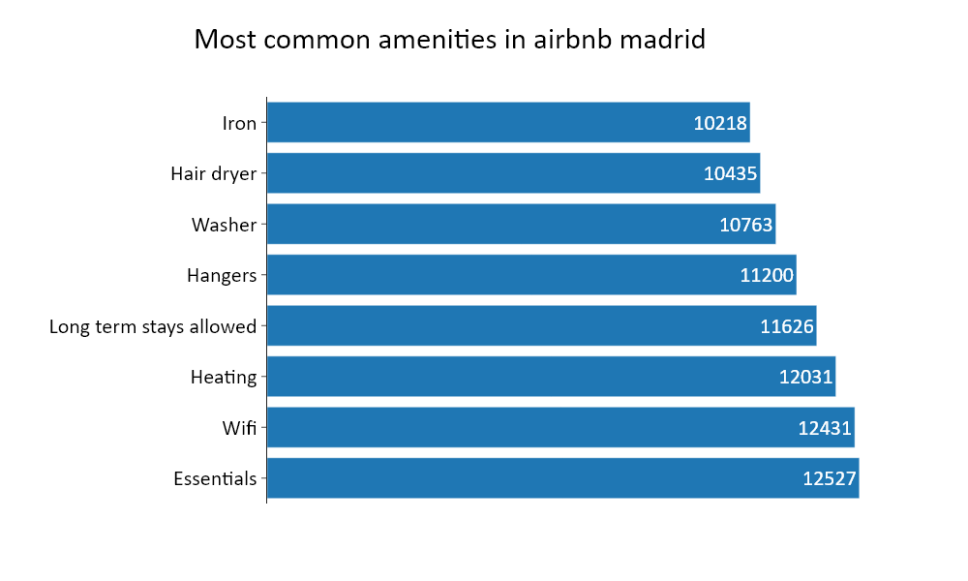
Most common amenities
airbnb madrid
7

Slide 8
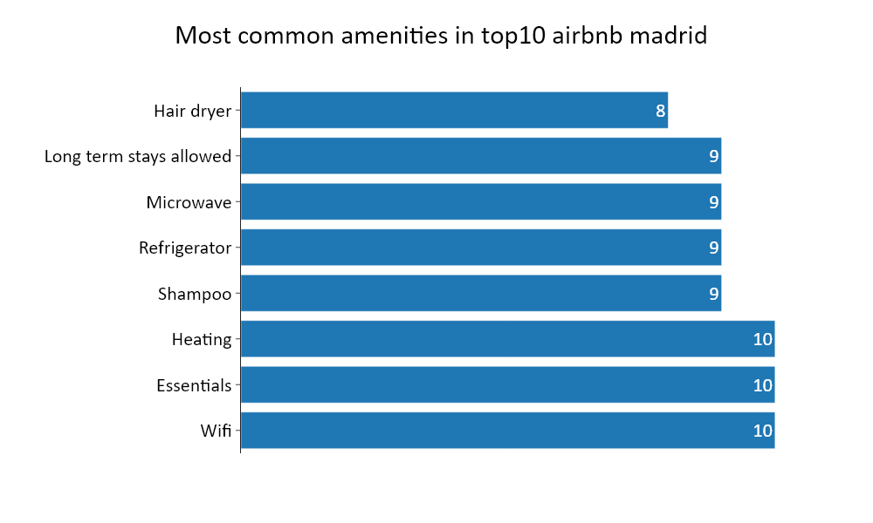
Most common amenities
airbnb madrid
8

Slide 9
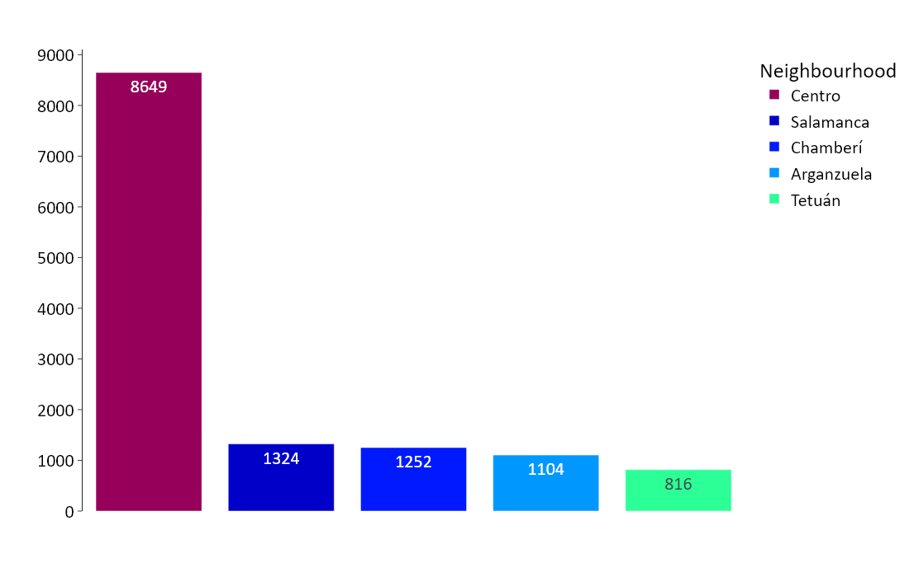
Top 5 neighbourhoods with most madrid airbnb properties
airbnb madrid
9

Slide 10

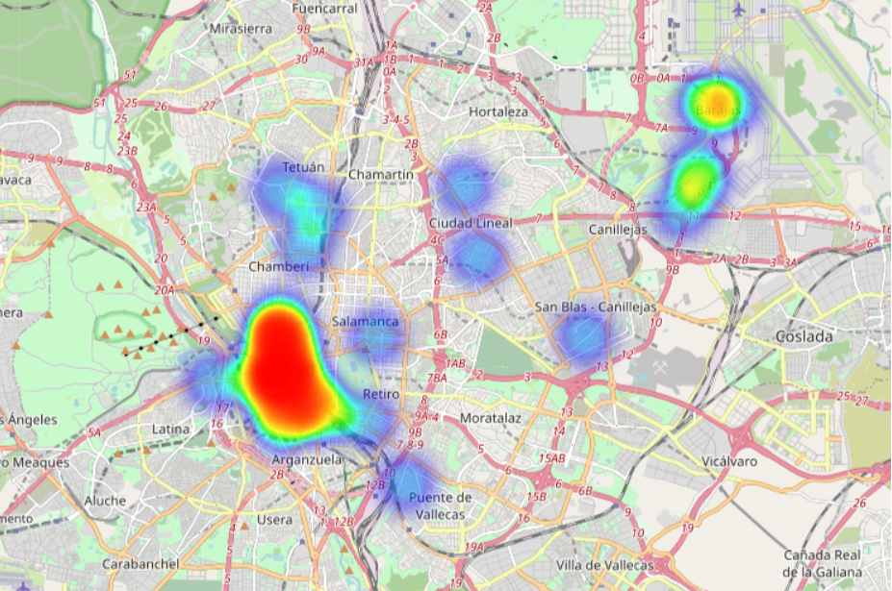
Neighborhoods of Top 100 airbnb properties based on ratings
Centro | 75 | Tetuan | 2 | Latina | 1
Barajas | 9 | Chamberi | 1 | Puente de Vallecas | 1
Arganzuela | 5 | Ciudal Lineal | 1 | Salamanca | 1
Retiro | 2 | Hortaleza | 1 | Canillejas | 1
airbnb madrid
10

Slide 11
Top 10 airbnb madrid map
https://airbnbtop10map.netlify.app/
airbnb madrid
11

Slide 12

Summary
Airbnb has a variety of room types which most popular is the entire apartments.
Airbnb prices is an important criteria for the customers.
Location also makes the difference for the selection of Airbnb.
airbnb madrid
12

